Slide 1
Simplified encoder-decoder architecture
…
…
…
…
Sequence of i/p features
Sequence of o/p tokens
Stack of encoder NNs
Hidden state
Stack of decoder NNs

Slide 2
Encoder RNN

Slide 4
years
recent
in
down
slowed
has
growth
h7: final hidden state
h6
h5
h4
h3
h2
Economic
h1
Encoder RNN
Initial hidden state
h6
h5
h4
h3
h2
h1

Slide 5
years
recent
in
down
slowed
has
growth
h6
h7
h1
h2
h3
h4
h5
Economic
h8: final hidden state
Encoder RNN
h0: Initial hidden state

Slide 6
BACKUP
Decoder RNN
s0
op1 = La
op2 = croissance
op4 = s’est
s3
op3= économique
s1
s2
s4
op0
Mapping process to output
h8: context vector
Encoding process
Economic | growth | has | slowed | down | in | recent | years
La croissance économique s’est ralentie ces dernières années

Slide 7
Decoder RNN
s0
op1 = La
op2 = croissance
op4 = s’est
op7 = dernières
op3= économique
op6 = ces
op5 = ralentie
s8
op8 = années
s3
s1
s2
s6
s4
s7
s5
op0
Mapping process to output
h8: context vector
dernières
années
La
croissance
économique
s’est
ralentie
ces
Encoding process
Economic | growth | has | slowed | down | in | recent | years
t = 8
t = 7
t = 6
t = 4
t = 5
t = 3
t = 2
t = 1

Slide 8








Dot product bw the hidden state and every o/p embedding – returns a set of scalars
SoftMax operation to normalize the scores
$$∙$$
La
= 0.9
= 0.04
$$∙$$
croissance
= 3.7
= 0.73
maximum
s2
$$∙$$
économique
= 0.3
= 0.02
s2
$$∙$$
s’est
= 1.3
= 0.07
s2
$$∙$$
s2
ralentie
= 1.1
= 0.05
s2
$$∙$$
ces
= 0.7
= 0.04
s2
$$∙$$
dernières
= 0.3
= 0.02
s2
$$∙$$
années
= 0.2
= 0.02
s2
Output op3 =

Slide 9
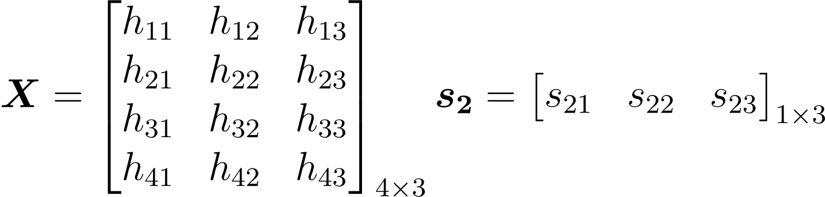

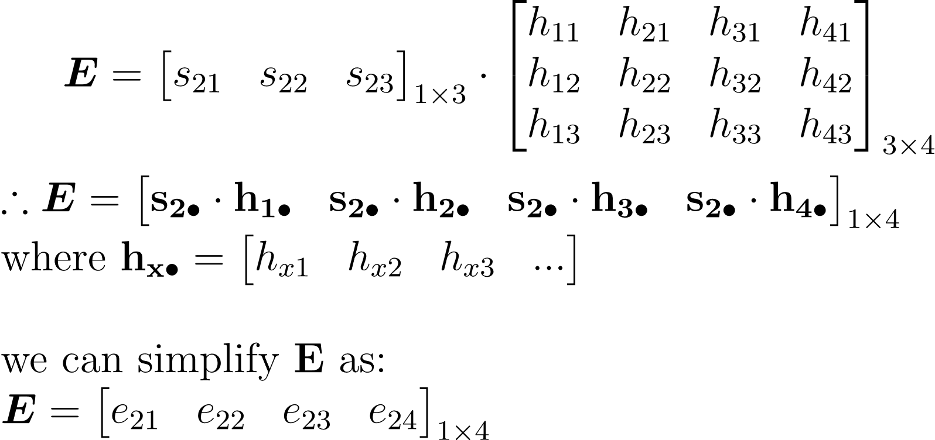
s₂: each hidden state vector (query vector): shape: N_{Q} x D_{Q} (Here N_{Q}=1 and D_{Q}=3)
X: grid of input features (database of keys) : shape: N_{X} x D_{Q} (N_{X} = 4)
e_xy: the wt which is obtained when the xth query vector is applied to the yth input feature (key)
Attn wt : query x key – just like a wt avg

Slide 10
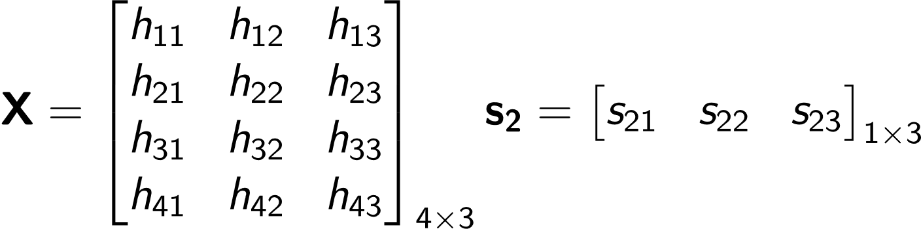
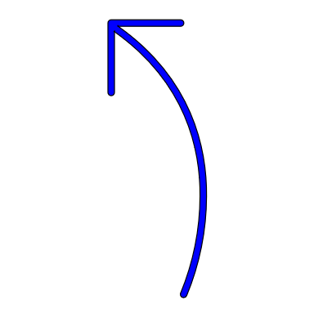
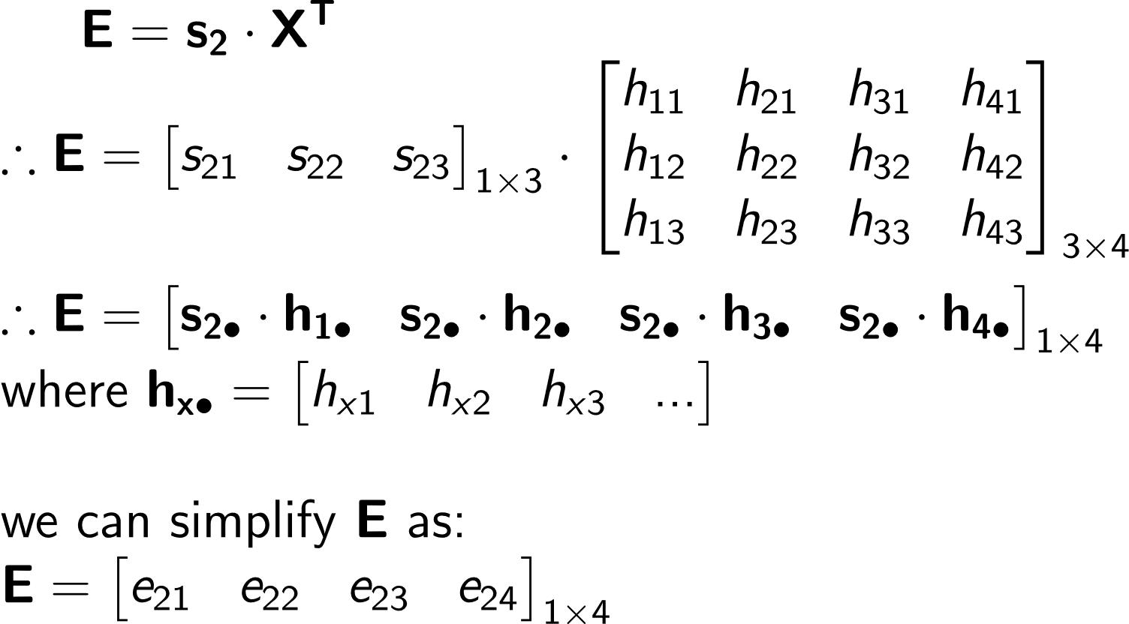

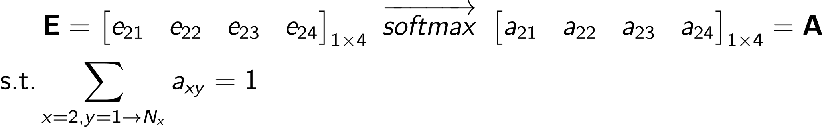
We have a grid of input features X of shape N_{X} x D_{Q} Here N_{X}=4 and D_{Q}=3
We have a hidden state s₂ of shape 1 x D_{Q}
Given this hidden state (query) we want to compute what wt to assign to each input feature (key) in order to generate the output
Step 1: initializing the variables
Raw attention scores
Step 2: computing the raw
Attention weights
Each element is a
scalar (weight)
e_{xy} : how much attention the xth query (hidden state) places on the yth key (feature). The dimension is 1 x N_{X}. 1 as we are considering one hidden state at a time and N_{X} is the number of i/p features
Step 3: normalize the
Attention weights
Normalized attention weight

Slide 11
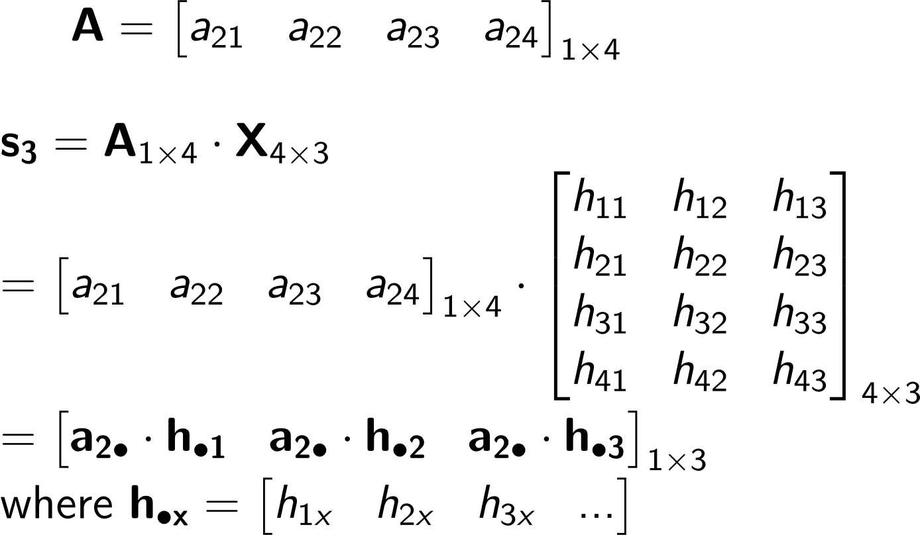
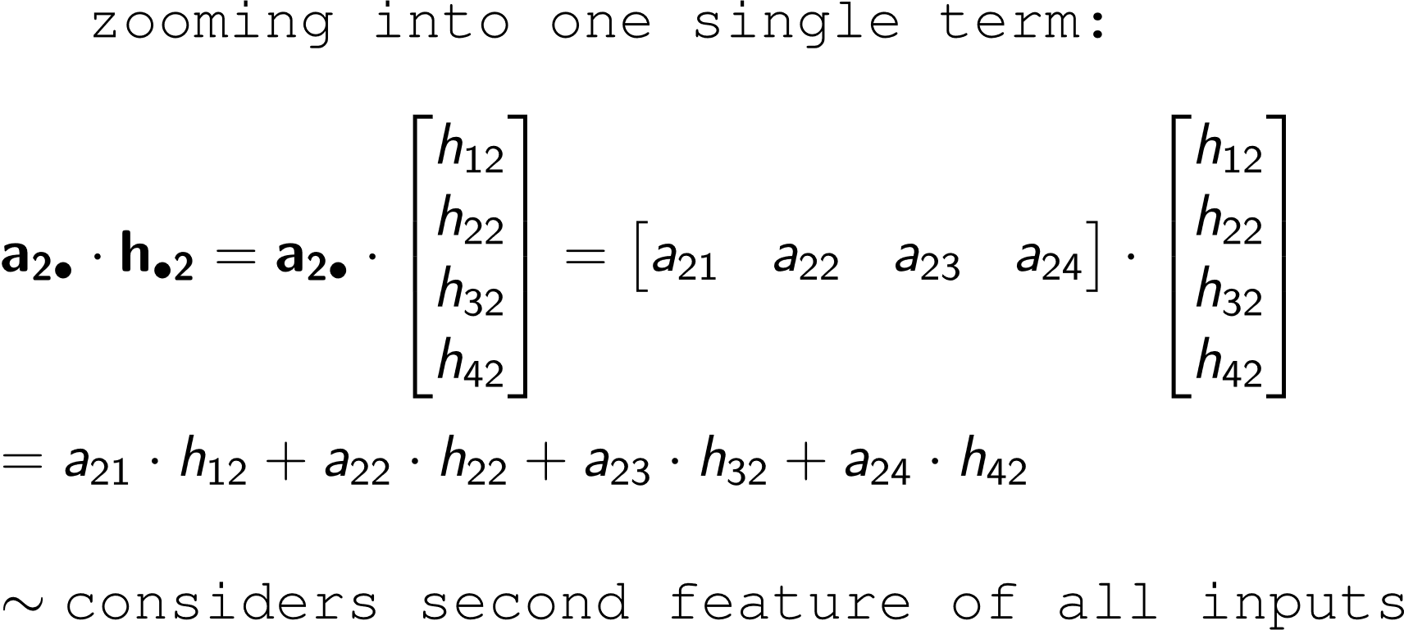
Till now we have computed the attention weights that should be assigned for each key given a query
The next aim is to calculate the new hidden state or the output of the process using these weights
New hidden state
Step 4: computing the raw
Attention weights
NOTE that the dimension of this new hidden state is same as s2 (1 x DQ)
Step 5: Understanding the purpose of attention:
Considers all input features upto a certain extent
The final op is just like a wt. avg over the input features
This eqn looks like a weighted average!
- Essentially, we are figuring out which features are important in what magnitudes

Slide 12
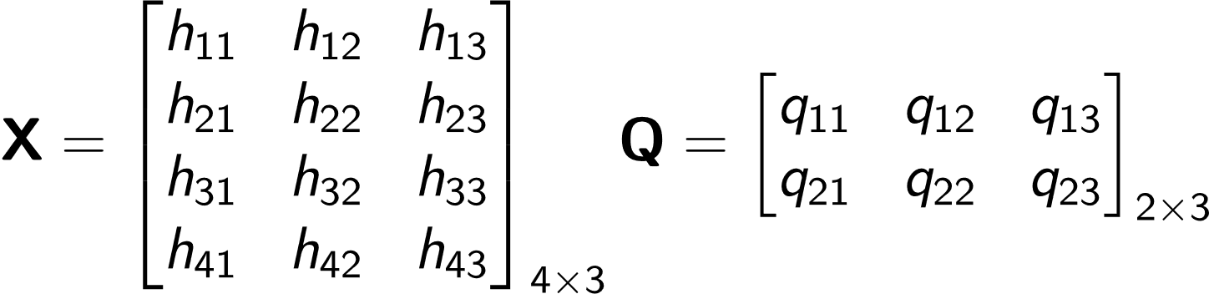
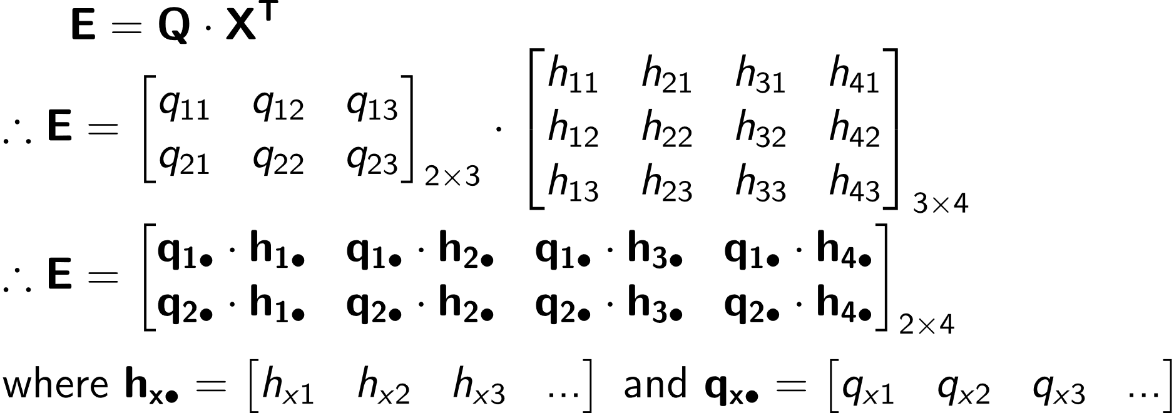
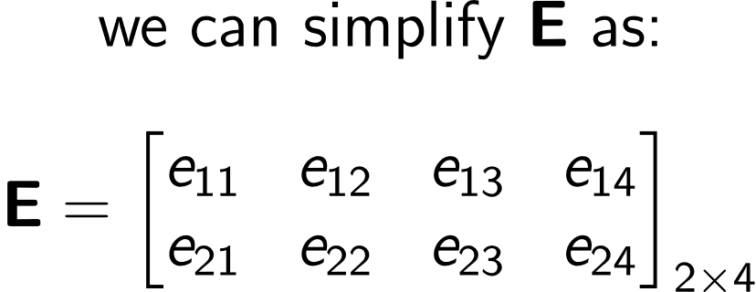
We have a grid of input features X of shape N_{X} x D_{Q} Here N_{X}=4 and D_{Q}=3
Instead of a single query vector, we have a set of query vectors (each of dimension D_{Q} ). So Q is a matrix of queries of shape N_{Q} x D_{Q} (assume N_{Q}=2)
Given a set of queries we want to compute what wt to assign to each input feature (key) in order to generate the output
Step 1: initializing the variables
Raw attention scores
E: Dot product of each query vector with each input feature(key)
i.e. : how similar is each query to a key
Step 2: computing the raw
Attention weights
Each element is a
scalar (weight)
e_{xy} : how much attention the xth query places on the yth key (feature)
The dimension of E is N_{Q} x N_{X} i.e for each query vector what is the weight assigned to each key

Slide 13
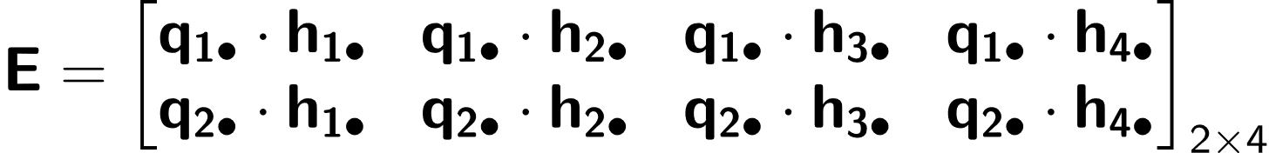
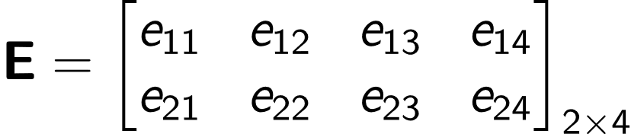
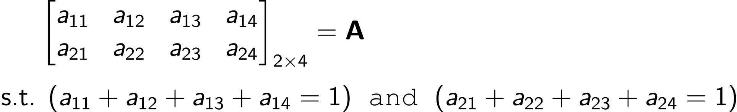
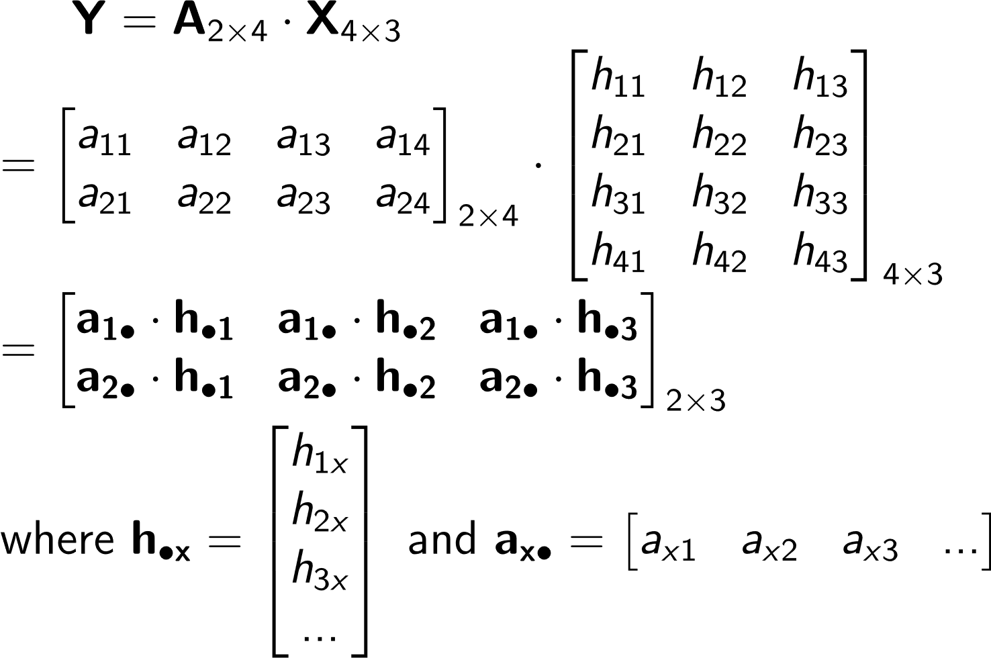
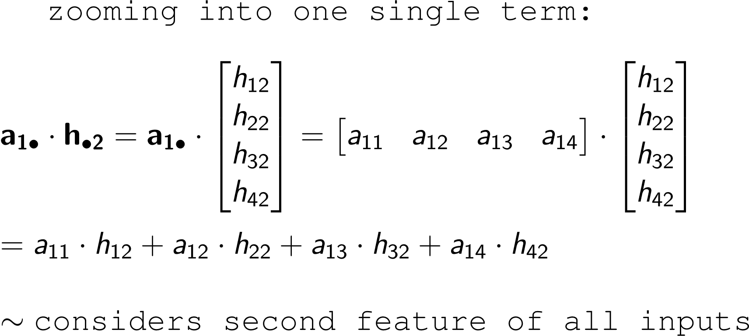
Till now we have computed the raw attention weights that should be assigned for each key given a query
The next aim is to calculate the outputs using these weights, but first we need to normalize them
This direction signifies the wts assigned to each input feature h1 to h4, so we should normalize the wts along this axis
Step 3: normalize the Attention weights
softmax
softmax
Step 5: Computing the Value (Y) matrix
Considers all input features upto a certain extent
The final op is just like a set of wt. averages over the input features
This is the output matrix. Shape: NQ x DQ: Num rows = number of queries as for each query we should get a value. Num columns : this signifies the no of features and is same as that in input features
This eqn looks like a weighted average!
- Essentially, we are figuring out which features are important in what magnitudes

Slide 14
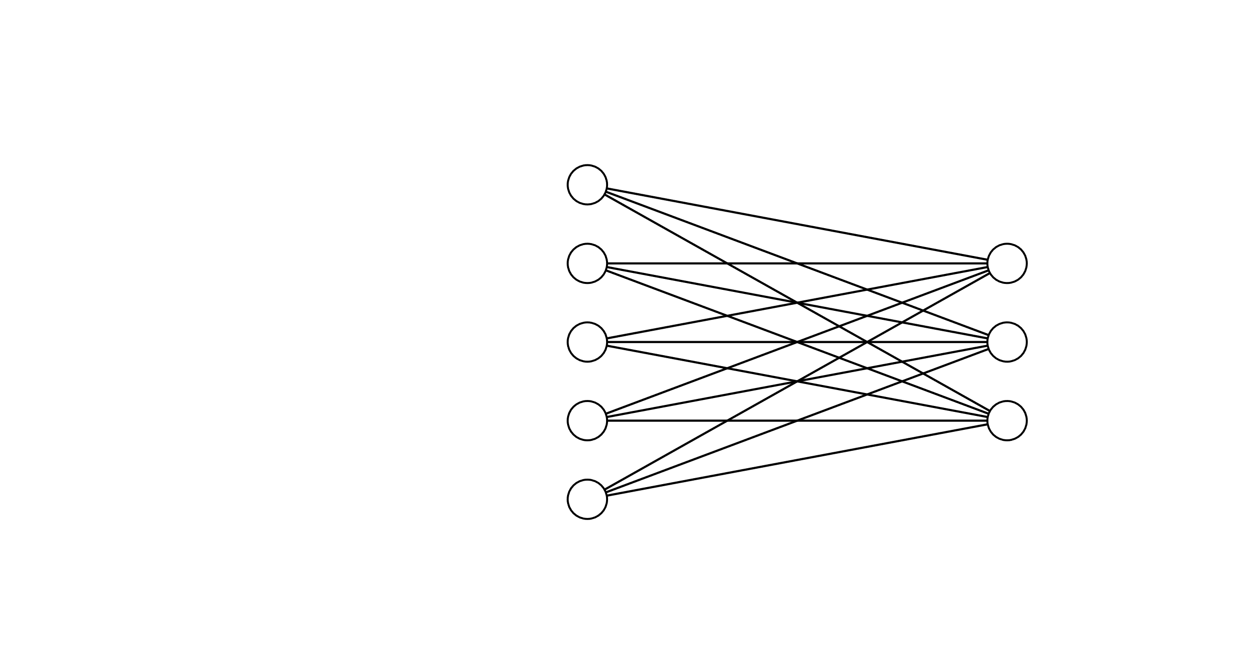
Step 1: Define the inputs:
Query matrix (Q)
The number of o/p dimensions we want (D_{V})
The input features matrix (X)
Step 2: Linear transformation from i/p features matrix (X)
to Key matrix (K)
Q
This is simply a NN that learns the weight matrix required to transform X -> K
N_{Q}
NN training
D_{X}
D_{Q}
D_{Q}
Note that in terms of dimensionality the dimension of K is same as that of X earlier (N_{X} x D_{Q}) – so all the math will be compatible
D_{V} : the number of o/p dimensions we want
W_{K}: D_{X} x D_{Q} learned weights
X
K
N_{X}
K = X.W_{K} | Shape: N_{X} x D_{Q}
N_{X}
Linear transformation from i/p features matrix
to Key matrix
D_{Q}
D_{X}
Key matrix Num rows: no of i/p features
Num cols/dimensions : same as that of Query matrix

Slide 15
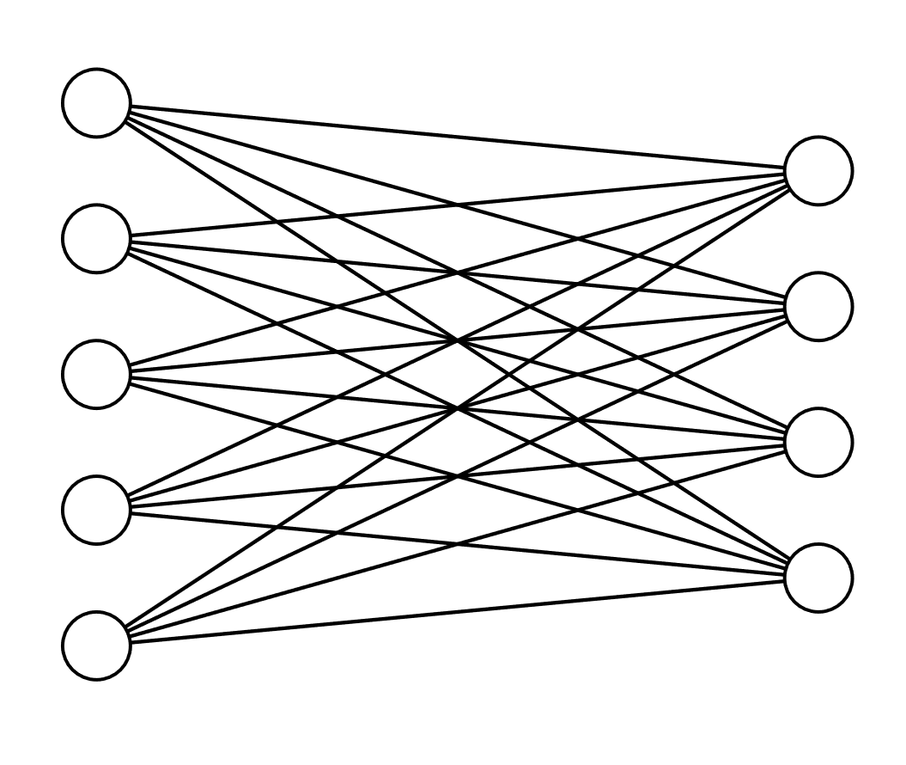
Step 1: Define the inputs:
Query matrix (Q)
The number of o/p dimensions we want (D_{V})
The input features matrix (X)
Step 2: Linear transformation from i/p features matrix (X)
to Value matrix (V)
Q
D_{V}
This is simply a NN that learns the weight matrix required to transform X -> V
N_{Q}
NN training
D_{X}
D_{Q}
D_{V} : the number of o/p dimensions we want (here assume 4)
W_{V}: D_{X} x D_{V} learned weights
X
V
N_{X}
V = X.W_{V} | Shape: N_{X} x D_{V}
N_{X}
Linear transformation from i/p features matrix
to Value matrix
D_{V}
D_{X}
Value matrix Num rows: no of i/p features
Num cols/dimensions : as specified by the task

Slide 16


Q
K
V
Step 1: Q, K, V matrices as computed before
N_{Q}
N_{X}
N_{X}
D_{Q}
D_{Q}
D_{V}
Step 2: Computing the raw attention weights
K^{T}
E
Each element is a
scalar (weight)
Q
E =
N_{Q}
.
D_{Q}
=
N_{Q}
D_{Q}
N_{X}
N_{X}
The dimension of E is N_{Q} x N_{X} i.e for each query vector what is the weight assigned to each key
E
A
Step 3: Normalizing the attention weights
N_{Q}
SoftMax
Along X axis
N_{Q}
Normalized attention weight
N_{X}
N_{X}
V
Step 4: Calculating the output matrix
A
Y
N_{Q}
.
N_{X}
Y =
=
N_{Q}
N_{X}
D_{V}
The dimension of Y is N_{Q} x D_{V}
Num of rows = no of queries
No of cols/dimensions is as we specify in the W_{V} matrix
D_{V}

Slide 17


CNN Network – acts as a feature extractor for the input image
An example feature map of shape 7 x 6 values
Each value gives information about a spatial feature in the image, some hypothetical examples are highlighted

Slide 18
Economic
growth
Economic
growth
has
has
slowed
slowed
down
Input tokens
in
down
recent
years
in
Word embeddings for the input tokens
…
recent
years
Embedding matrix – stores the embedding for each word in the vocabulary

Slide 19

1
Previous hidden state of the decoder
Input features : encoder hidden states
2
3
Basically, through this function what we are trying to answer is that given the previous hidden state what weights to assign to an i/p feature in order to predict the o/p
This function is learned by a feed forward neural net

Slide 20
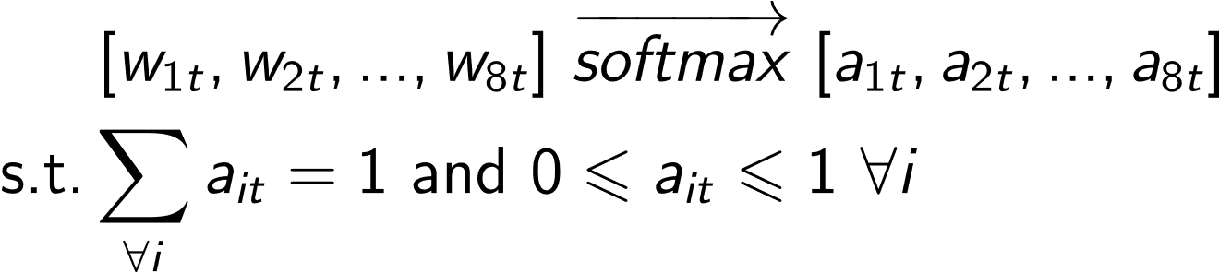
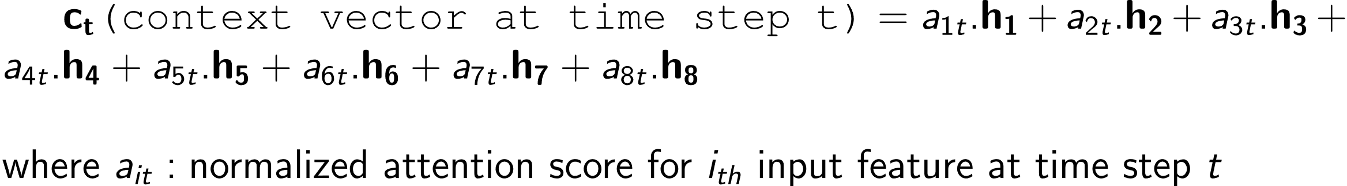
Raw attention weights
4
Normalized attention scores
5

